Slide 1
Row-Level Security in SSRS and SSAS SQL Saturday #514 Houston, TX; May 14, 2016

Slide 2
About Me
Chris Hyde
Owner and Principal Consultant with Hydrate Consulting
MCSA – SQL Server 2008, MCITP
15+ Years experience with SQL Server
Contact Me:
Email: chrishyde325@gmail.com or chris@hydrate.consulting
Twitter: @ChrisHyde325

Slide 3
This Presentation
http://www.sqlsaturday.com/514/Sessions/Schedule.aspx
https://github.com/DrJekyll325/SQLServer/tree/master/Presentations

Slide 4
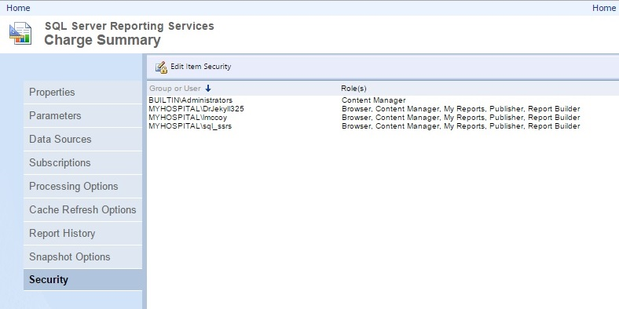
Object-Level Security, part 1

Slide 5
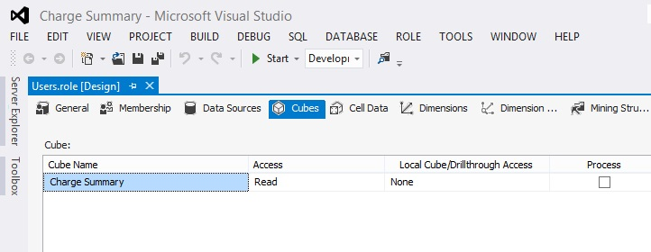
Object-Level Security, part 2

Slide 6
Row-Level Security
The user is granted permission to access a particular report, cube, or tabular model.
However, the user does not have access to all of the rows of data in that object.
For example, a sales representative may only have access to data related to her clients.

Slide 7

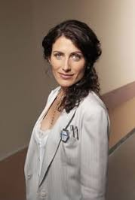


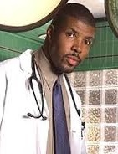
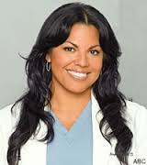

The Case Study (Slightly Fictionalized)
My Fictional Hospital
MFH

Slide 8
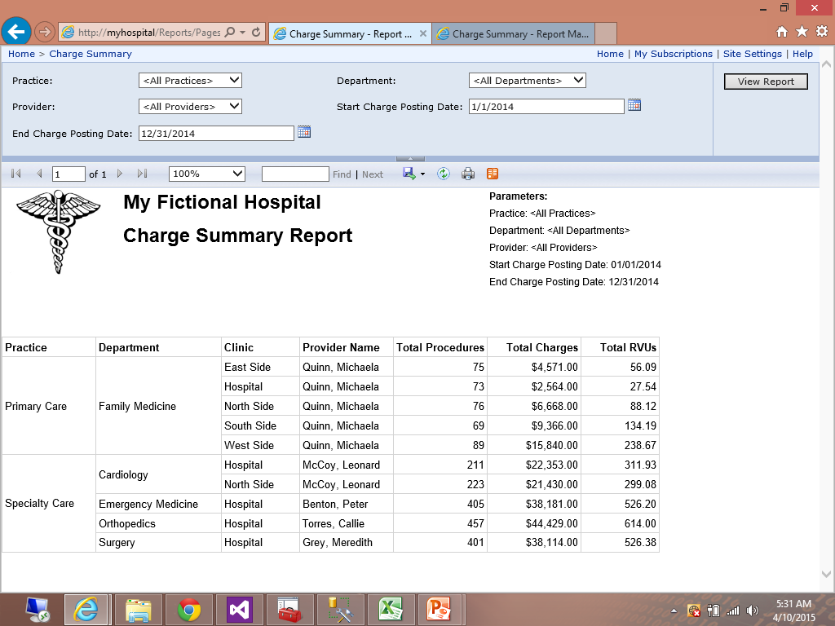
Reports!

Slide 9
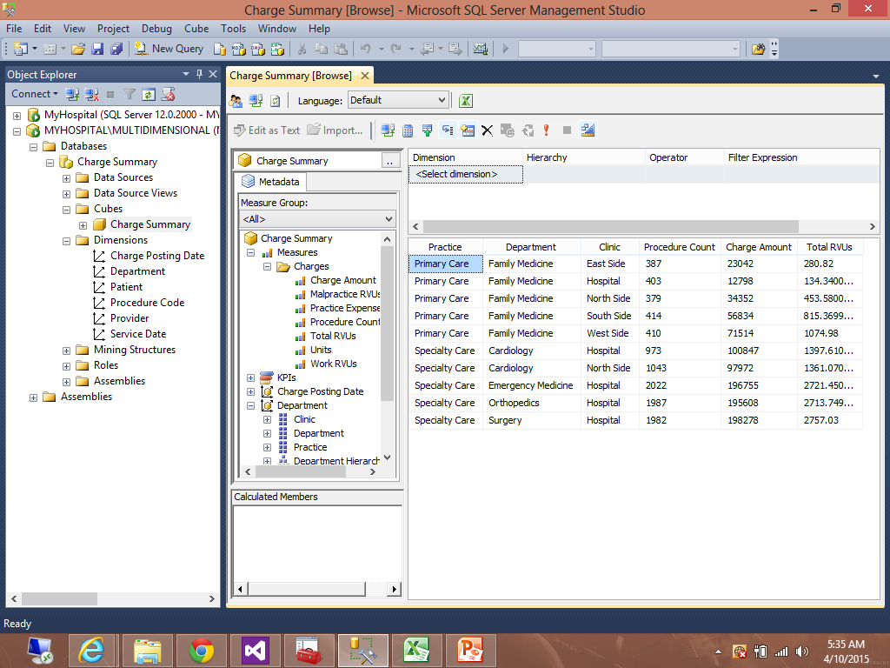
Cubes!

Slide 10
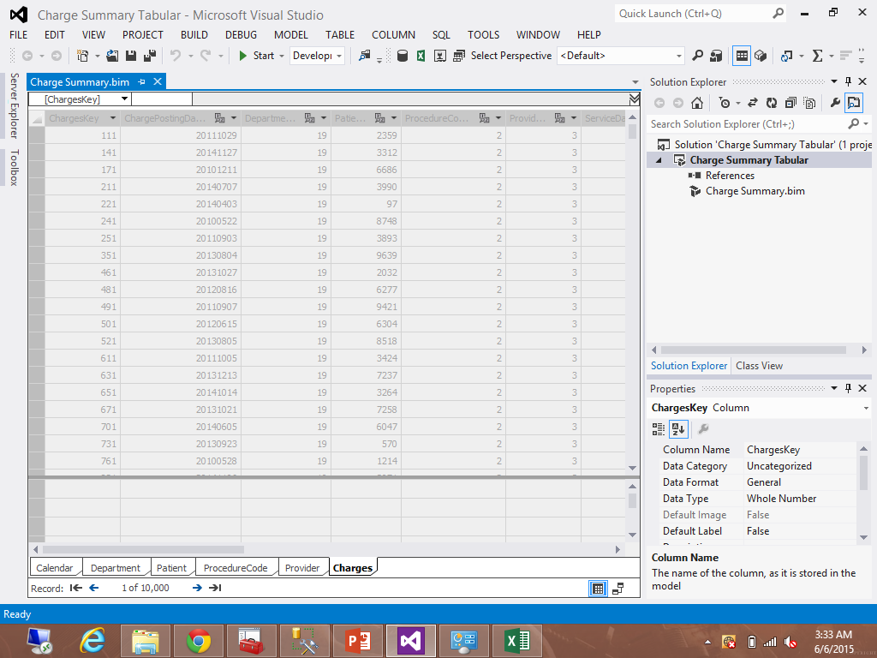
Even Tabular Models!

Slide 11
Problems!
Dr. Cuddy: Chris, we have a problem! The Primary Care doctors are revolting!
Me: Phrasing!
Dr. Cuddy: They’ve been running your reports and now they’re upset that their revenue is so much less than the Specialists.
Can you change the reports so all of the providers can only see their own departments?

Slide 12
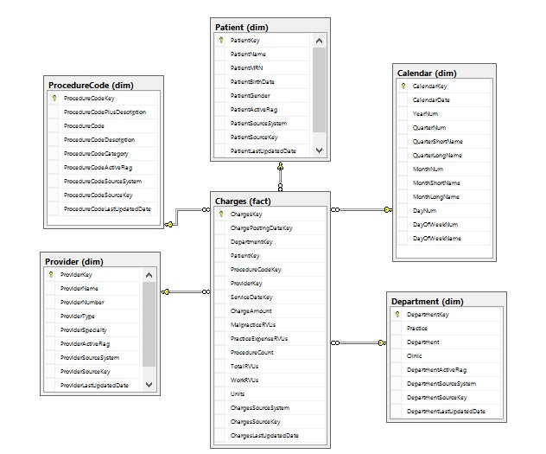
Data Warehouse Schema

Slide 13
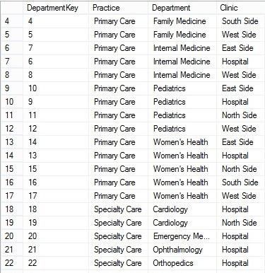
Department Dimension

Slide 14
The Troublesome Report
http://myhospital/Reports/Pages/Report.aspx?ItemPath=%2fCharge+Summary

Slide 15
The Interviews, part 1
Dr. Benton: I need access to Emergency Medicine data, STAT!
Dr. Torres: I’ve been an Orthopedic Surgeon for at least two seasons now!

Slide 16
The Interviews, part 2
Dr. McCoy: Damnit, Jim, I’m a Cardiologist, not a General Practitioner!
Me: Uh, my name’s not Jim, sir!
Dr. Quinn: I’m just an ordinary Medicine Woman.
Me: A Family Medicine doctor, then?

Slide 17
The Interviews, part 3
Dr. Grey: You don’t even watch my show! I bet you don’t know what type of doctor I am!
Me: Uh, an Anatomist?
Dr. Grey: You know that’s not a type of doctor, right? <sigh> I’m a surgeon.
Dr. Cuddy: Don’t forget that as the Dean of Medicine I still need access to all departments.

Slide 18
Create Users Table
CREATE TABLE
sec.Users
(
UserKey INT IDENTITY(1, 1),
UserName VARCHAR(20) NOT NULL,
UserLogin VARCHAR(25) NOT NULL,
AllDepartmentsFlag CHAR(1) NOT NULL
);
ALTER TABLE sec.Users ADD CONSTRAINT PK_User PRIMARY KEY (UserKey);

Slide 19
Populate Users Table
INSERT INTO sec.Users (UserName, UserLogin, AllDepartmentsFlag)
VALUES ('Benton, Peter', 'MyHospital\pbenton', 'N');
INSERT INTO sec.Users (UserName, UserLogin, AllDepartmentsFlag)
VALUES ('Cuddy, Lisa', 'MyHospital\lcuddy', 'Y');
INSERT INTO sec.Users (UserName, UserLogin, AllDepartmentsFlag)
VALUES ('Grey, Meredith', 'MyHospital\mgrey', 'N');
INSERT INTO sec.Users (UserName, UserLogin, AllDepartmentsFlag)
VALUES ('McCoy, Leonard', 'MyHospital\lmccoy', 'N');
Etc…

Slide 20
Create User-Department Table, part 1
CREATE TABLE
sec.UserDepartment
(
UserDepartmentKey INT IDENTITY(1, 1),
DepartmentKey INT NOT NULL,
UserKey INT NOT NULL,
StartEffectiveDate DATE NOT NULL,
EndEffectiveDate DATE NOT NULL
);
ALTER TABLE sec.UserDepartment ADD CONSTRAINT PK_UserDepartment PRIMARY KEY (UserDepartmentKey);

Slide 21
Create User-Department Table, part 2
ALTER TABLE sec.UserDepartment ADD CONSTRAINT FK_UserDepartment_Department
FOREIGN KEY (DepartmentKey)
REFERENCES dim.Department (DepartmentKey);
ALTER TABLE sec.UserDepartment ADD CONSTRAINT FK_UserDepartment_User
FOREIGN KEY (UserKey)
REFERENCES sec.Users (UserKey);

Slide 22
Populate User-Department Table, part 1
INSERT INTO
sec.UserDepartment
(
DepartmentKey,
UserKey,
StartEffectiveDate,
EndEffectiveDate
)
SELECT
Dept.DepartmentKey,
Usr.UserKey,
CAST(SYSDATETIME() AS DATE),
'2099-12-31'
FROM
sec.Users Usr
CROSS JOIN
dim.Department Dept
WHERE
Usr.AllDepartmentsFlag = 'Y';

Slide 23
Populate User-Department Table, part 2
INSERT INTO
sec.UserDepartment
(
DepartmentKey,
UserKey,
StartEffectiveDate,
EndEffectiveDate
)
SELECT
Dept.DepartmentKey,
Usr.UserKey,
CAST(SYSDATETIME() AS DATE),
'2099-12-31'
FROM
sec.Users Usr
INNER JOIN
dim.Provider Prov
ON Usr.UserName = Prov.ProviderName
INNER JOIN
dim.Department Dept
ON Prov.ProviderSpecialty = Dept.Department
WHERE
Usr.AllDepartmentsFlag = 'N';

Slide 24
Populate User-Department Table, part 3
UPDATE
UsrDept
SET
EndEffectiveDate = '2015-05-31'
FROM
sec.UserDepartment UsrDept
INNER JOIN
sec.Users Usr
ON UsrDept.UserKey = Usr.UserKey
INNER JOIN
dim.Department Dept
ON UsrDept.DepartmentKey = Dept.DepartmentKey
WHERE
Usr.UserName = 'Hyde, Chris'
AND
Dept.Department = 'Cardiology';

Slide 25
Update Report Parameter Procedures, part 1
CREATE PROCEDURE report.uspReportParameters_Practice
(
@AllowSelectAllPractices BIT
)
AS
BEGIN
SELECT
PracticeName = '<All Practices>'
WHERE
@AllowSelectAllPractices = 1
UNION ALL
SELECT DISTINCT
PracticeName = Dept.Practice
FROM
MyHospital.dim.Department Dept
ORDER BY
PracticeName;
END;

Slide 26
Update Report Parameter Procedures, part 2
CREATE PROCEDURE report.uspReportParameters_Practice_WithSecurity
(
@AllowSelectAllPractices BIT,
@ExecutedByUser VARCHAR(25)
)
AS
BEGIN
SELECT
PracticeName = '<All Practices>'
WHERE
@AllowSelectAllPractices = 1
UNION ALL
SELECT DISTINCT
PracticeName = Dept.Practice
FROM
MyHospital.dim.Department Dept
INNER JOIN
sec.UserDepartment UsrDept
ON Dept.DepartmentKey = UsrDept.DepartmentKey AND SYSDATETIME() BETWEEN UsrDept.StartEffectiveDate AND UsrDept.EndEffectiveDate
INNER JOIN
sec.Users Usr
ON UsrDept.UserKey = Usr.UserKey
WHERE
Usr.UserLogin = @ExecutedByUser
ORDER BY
PracticeName;
END;

Slide 27
Update Report Parameter Procedures, part 3
CREATE PROCEDURE report.uspReportParameters_Department
(
@PracticeName VARCHAR(20),
@AllowSelectAllDepartments BIT
)
AS
BEGIN
SELECT
DepartmentName = '<All Departments>'
WHERE
@AllowSelectAllDepartments = 1
UNION ALL
SELECT DISTINCT
DepartmentName = Dept.Department
FROM
MyHospital.dim.Department Dept
WHERE
@PracticeName = '<All Practices>'
OR
Dept.Practice = @PracticeName
ORDER BY
DepartmentName;
END;

Slide 28
Update Report Parameter Procedures, part 4
CREATE PROCEDURE report.uspReportParameters_Department_WithSecurity
(
@PracticeName VARCHAR(20),
@AllowSelectAllDepartments BIT,
@ExecutedByUser VARCHAR(25)
)
AS
BEGIN
SELECT
DepartmentName = '<All Departments>'
WHERE
@AllowSelectAllDepartments = 1
UNION ALL
SELECT DISTINCT
DepartmentName = Dept.Department
FROM
MyHospital.dim.Department Dept
INNER JOIN
sec.UserDepartment UsrDept
ON Dept.DepartmentKey = UsrDept.DepartmentKey AND SYSDATETIME() BETWEEN UsrDept.StartEffectiveDate AND UsrDept.EndEffectiveDate
INNER JOIN
sec.Users Usr
ON UsrDept.UserKey = Usr.UserKey
WHERE
(@PracticeName = '<All Practices>'
OR
Dept.Practice = @PracticeName)
AND
Usr.UserLogin = @ExecutedByUser
Etc…

Slide 29
Update Report Parameter Procedures, part 5
CREATE PROCEDURE report.uspReportParameters_Provider
(
@AllowSelectAllProviders BIT
)
AS
BEGIN
SELECT
ProviderKey = -1,
ProviderName = '<All Providers>'
WHERE
@AllowSelectAllProviders = 1
UNION ALL
SELECT
ProviderKey = Prov.ProviderKey,
ProviderName = Prov.ProviderName
FROM
MyHospital.dim.Provider Prov
ORDER BY
ProviderName;
END;

Slide 30
Update Report Procedure
Shown in SQL Server Management Studio

Slide 31
Update Report
Shown in SSRS Report Manager, then in SQL Data Tools.

Slide 32
More Problems!
Dr. Cuddy: Great job getting the security on that report tightened up!
Me: Thanks, Dr. Cuddy!
Dr. Cuddy: However, some of our providers have access to the Charges Summary cube and can still see other departments data.
Can you change the security in the cubes too?

Slide 33
A Helpful White Paper!
“Extending Role Security in Analysis Services for SQL Server” by Bill Kenworthy
http://www.globalknowledge.com/training/whitepaperdetail.asp?pageid=502&wpid=1238&country=United+States

Slide 34
Create View for Multidimensional Cube
CREATE VIEW
vwUserDepartmentActive
AS
SELECT
DepartmentKey,
UserKey
FROM
MyHospital.sec.UserDepartment Dept
WHERE
CAST(SYSDATETIME() AS DATE) BETWEEN Dept.StartEffectiveDate AND Dept.EndEffectiveDate;

Slide 35
Update Multidimensional Cube
Shown in SQL Data Tools.

Slide 36
No End to the Problems!
Dr. Cuddy: Looks like we forgot about those tabular models, and now some of our providers are using those instead of the cubes. Can we make those security changes there as well?
Me: Sure thing. I’ll get right on it!

Slide 37
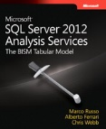
Microsoft Press to the Rescue!
SQL Server 2012 Analysis Services: The BISM Tabular Model by Marco Russo, Alberto Ferrari, and Chris Webb
Implementing Dynamic Security by Using USERNAME, pp. 481-482

Slide 38
Create View for Tabular Model
CREATE VIEW
vwTabularPermissions
AS
SELECT DISTINCT
Dept.DepartmentKey,
Usr.UserLogin
FROM
MyHospital.sec.UserDepartment Dept
INNER JOIN
MyHospital.sec.Users Usr
ON Dept.UserKey = Usr.UserKey
WHERE
CAST(SYSDATETIME() AS DATE) BETWEEN Dept.StartEffectiveDate AND Dept.EndEffectiveDate;

Slide 39
Update Tabular Model
Shown in SQL Data Tools.

Slide 40
DAX Filter on Department
= CONTAINS
(
vwTabularPermissions,
vwTabularPermissions[UserLogin], USERNAME(),
vwTabularPermissions[DepartmentKey], Department[DepartmentKey]
)

Slide 41
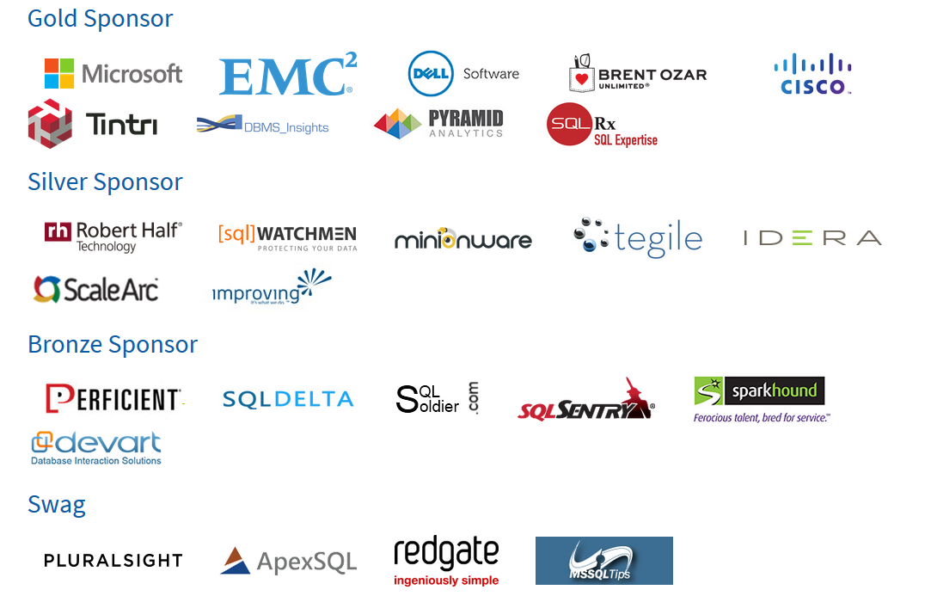

Thank Our Sponsors!
Visit the Sponsor tables to enter their end of day raffles.
Turn in your completed Event Evaluation form at the end of the day in the Registration area to be entered in additional drawings.
Want more free training? Check out the Houston Area SQL Server User Group which meets on the 2nd Tuesday of each month. Details at http://houston.sqlpass.org

